Slide 1
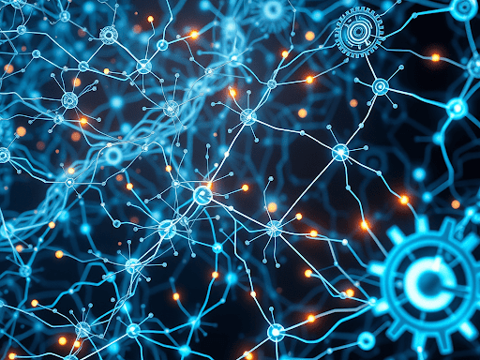
Computer Aided Verification Final Project
December 2025
Formal Verification of Neural Networks
Kendall Ahern

Slide 2


GitHub Repo:
github.com/kendallahern/CAV_FinalProject

Slide 3
Introduction to Neural Network Security and the Challenge of Trustworthy AI
Neural networks are being integrated into high-stakes domains – reliability is paramount
These models must be dependable, as failures can have critical consequences\
Adversarial Perturbations: These are small, often imperceptible, changes made to a model's input that can cause it to produce a completely incorrect output.
Limits of Empirical Methods: While standard testing and attack-based evaluations can find some vulnerabilities, they cannot provide absolute guarantees of safety. They can demonstrate the presence of flaws but cannot prove their absence.
Need for Formal Guarantees: Need formal methods/techniques to mathematically prove that a model is robust to all possible perturbations within a specified neighborhood of a given input.
This project's goal was to address this need directly: To explore and implement a pipeline for formally verifying the local adversarial robustness of neural networks using SMT solvers.

Slide 4
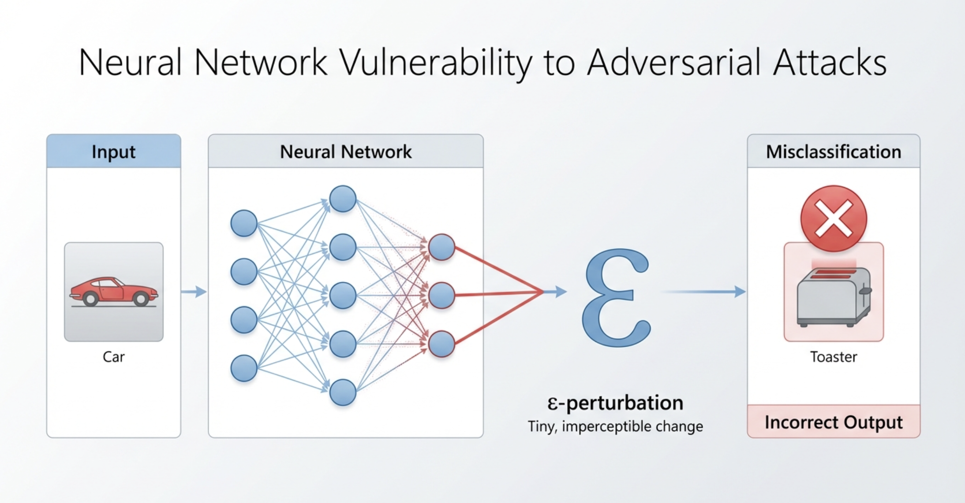

Slide 5

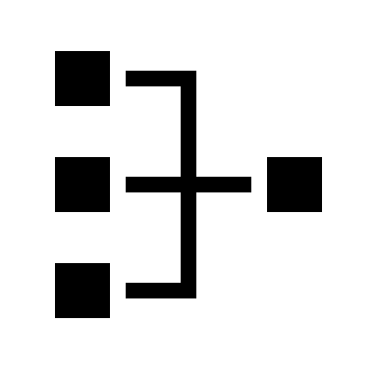

Background: Core Concepts
Local Adversarial Robustness
Neural network's prediction stability around a specific input.
Does the model's output remains constant for all possible inputs within a small, ε-bounded neighborhood?
∀x(||x−x₀||∞ ≤ ε) → f(x) = f(x₀)
If this property holds, the model is provably safe.
The ReLU Problem
The Rectified Linear Unit (ReLU) introduces non-linearity into networks, enabling complex pattern learning.
Creates a piecewise-linear computation graph.
”Combinatorial explosion" of distinct linear regions.
For a network with n ReLU units, there can be up to 2ⁿ possible activation patterns
SMT-Based Verification eeeeee with Z3
Z3 is a general-purpose SMT Solver that we used in class.
Neural networks can be encoded as formal constraints.
Affine layers: z = Wx + b
ReLU activations: a = max(0, z) via conditional expressions
Combined with robustness property: Z3 can systematically search for counterexamples

Slide 6
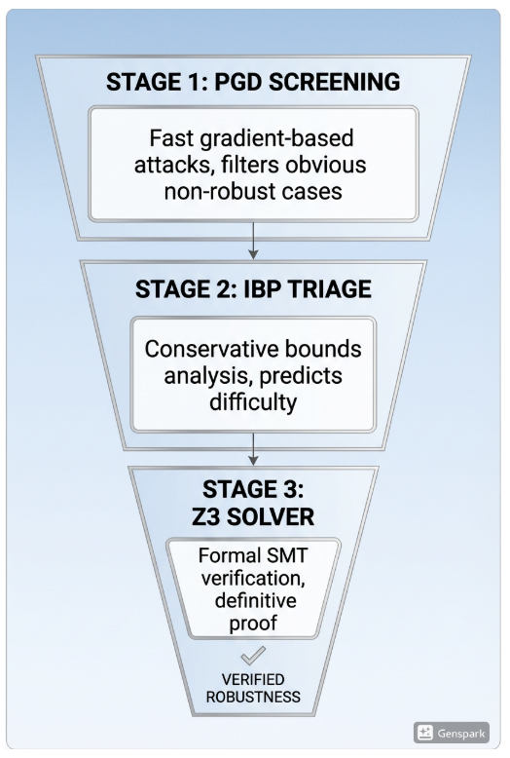
The Verification Funnel
July 2024
The multi-stage architecture progressively filters candidate inputs:
1
PGD Screening (Fast)
Empirical attacks to quickly identify vulnerable inputs
IBP Triage (Medium)
Conservative bounds to predict verification difficulty
Z3 Solver (Exact)
Formal verification for the most challenging cases

Slide 7
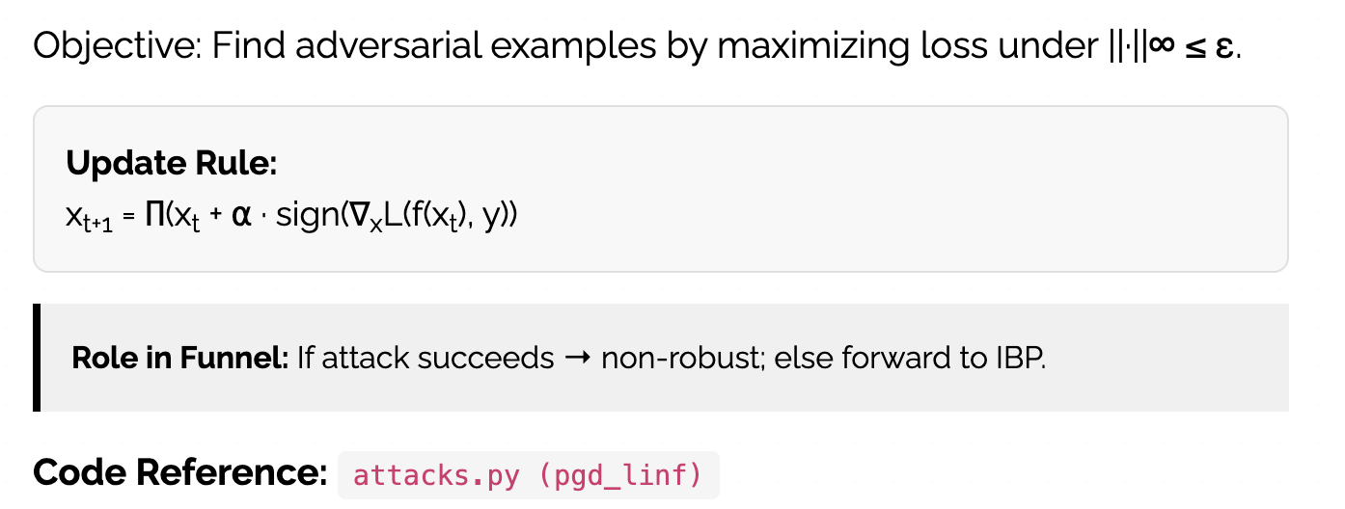
STAGE 1: PGD EMPIRICAL FILTER

Slide 8
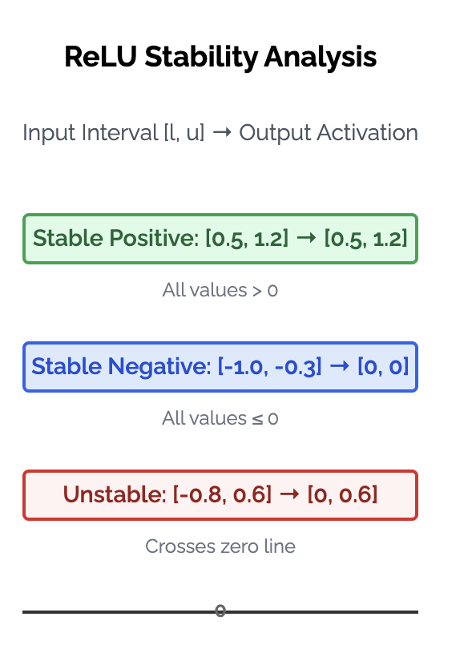
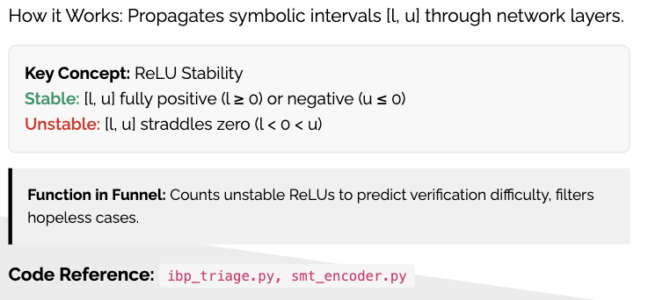
STAGE 2:
IBP TRIAGE & COMPLEXITY
See Diagram on Next Slide

Slide 9
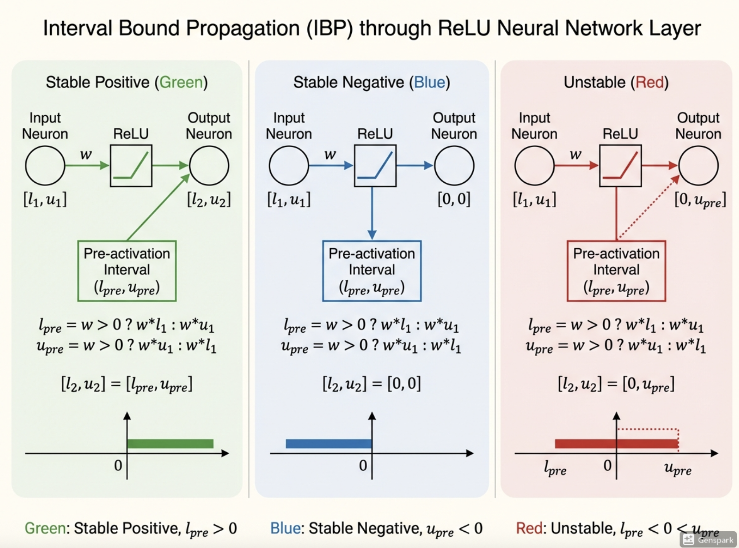

Slide 10
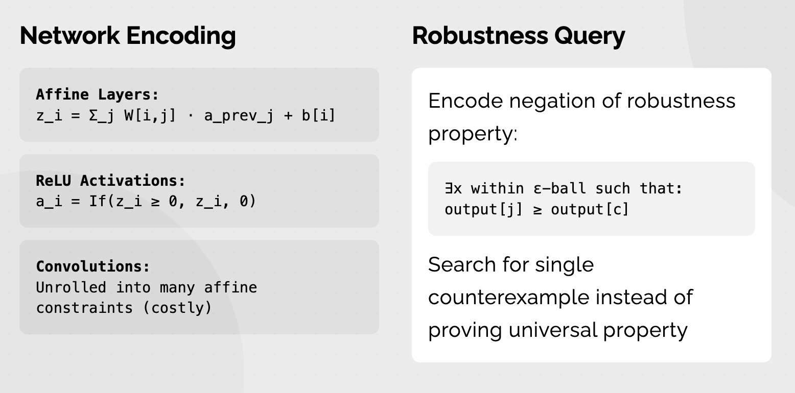
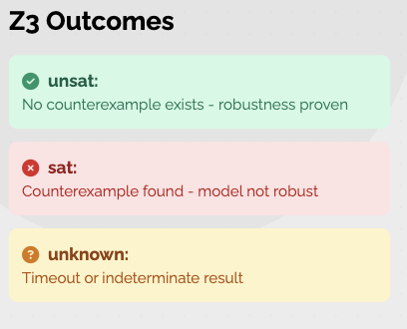
STAGE 3: SMT ENCODING ANDFORMAL VERIFICATION IN Z3

Slide 11
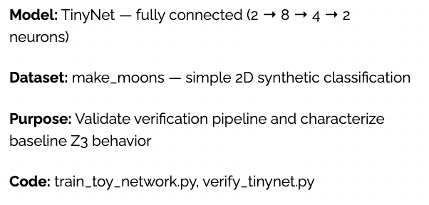
Case Study 1: Testing TinyNet
Experimental Results
1. ε = 0.001: Z3 returns unsat quickly; IBP shows mostly stable ReLUs
2. ε = 0.01: PGD often finds adversarial examples; Z3 returns sat with counterexamples
Insight: Z3 runtime correlates with number of unstable ReLUs
Conclusion: Small networks tractable for small perturbations

Slide 12
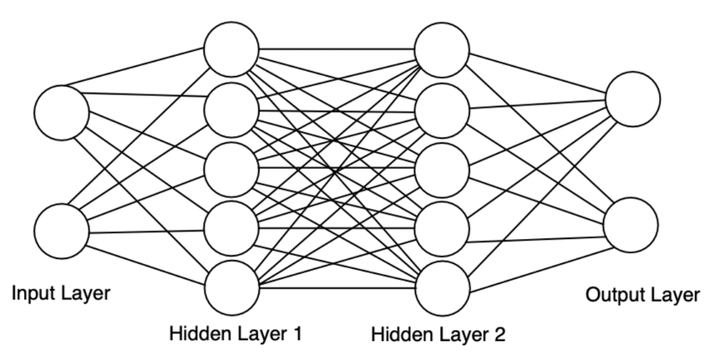

Slide 13
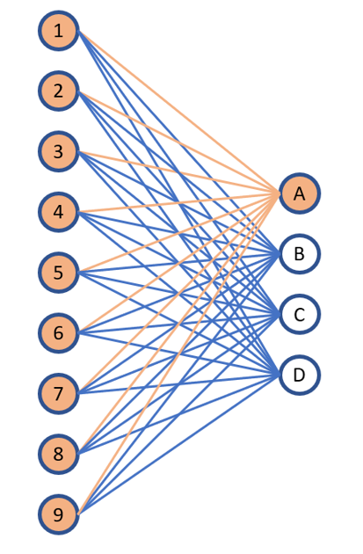
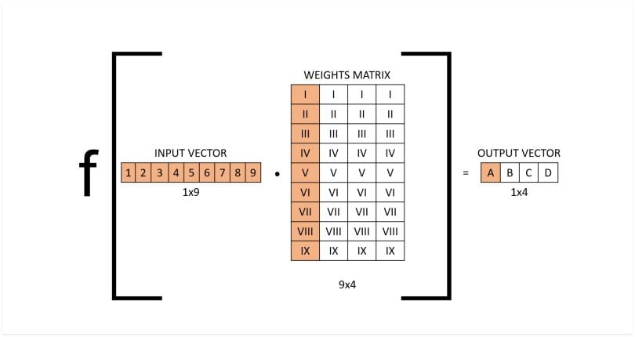
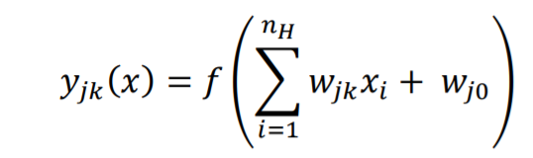

Slide 14
Case Study 1: Testing TinyNet
Experimental Results
1. ε = 0.001: Z3 returns unsat quickly; IBP shows mostly stable ReLUs
2. ε = 0.01: PGD often finds adversarial examples; Z3 returns sat with counterexamples
Insight: Z3 runtime correlates with number of unstable ReLUs
Conclusion: Small networks tractable for small perturbations

Slide 15
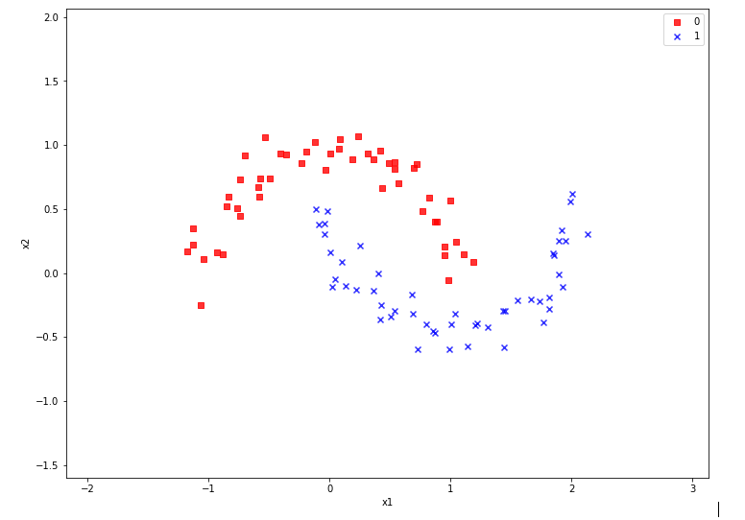
Make Moons Dataset:
Set of 2D data points (x,y)
Each point is assigned a binary label (0 or 1) corresponding to which half-circle it belongs to.
It's ideal for visualizing and testing how well algorithms can separate non-linearly separable data, as the two "moons" are not linearly separable from each other.
Link to Dataset and Documentation:
https://scikit-learn.org/stable/modules/generated/sklearn.datasets.make_moons.html

Slide 16
Case Study 1: Testing TinyNet
Experimental Results
1. ε = 0.001: Z3 returns unsat quickly; IBP shows mostly stable ReLUs
2. ε = 0.01: PGD often finds adversarial examples; Z3 returns sat with counterexamples
Insight: Z3 runtime correlates with number of unstable ReLUs
Conclusion: Small networks tractable for small perturbations

Slide 17
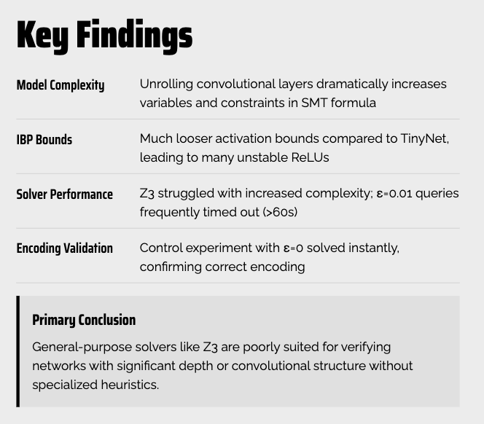
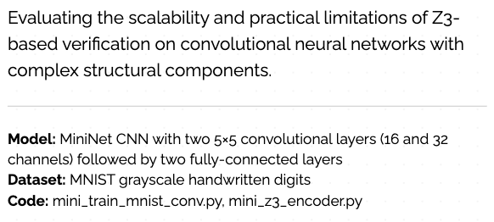
Case Study 2: MININET (MNIST CNN)

Slide 18
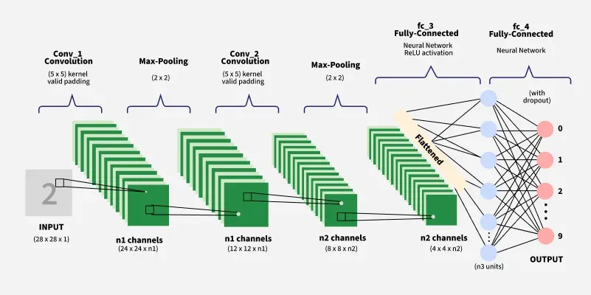

Slide 19
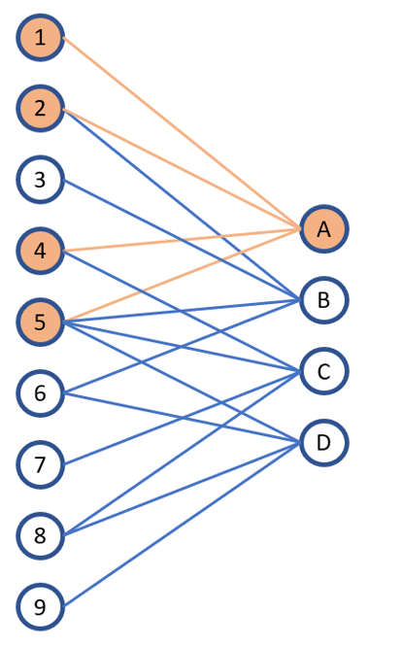
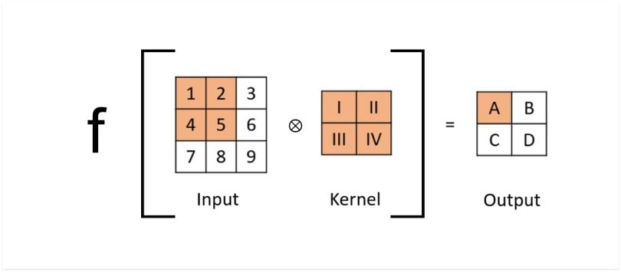
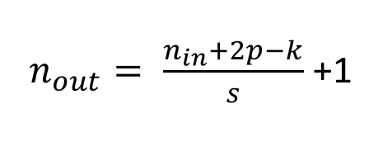

Slide 22
Case Study 2: MININET (MNIST CNN)

Slide 23
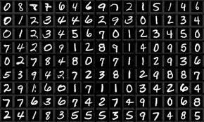
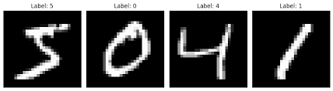
MNIST Handwritten Letters Dataset:
Labeled handwritten digits (0-9)
Training set of 60,000 images
Test set of 10,000 images.
Each image is a 28x28 pixel grayscale image, size-normalized, and centered in a fixed-size square.
Benchmark for machine learning and pattern recognition algorithms
Link to Dataset and Documentation:
https://www.kaggle.com/datasets/hojjatk/mnist-dataset

Slide 24
Case Study 2: MININET (MNIST CNN)

Slide 25

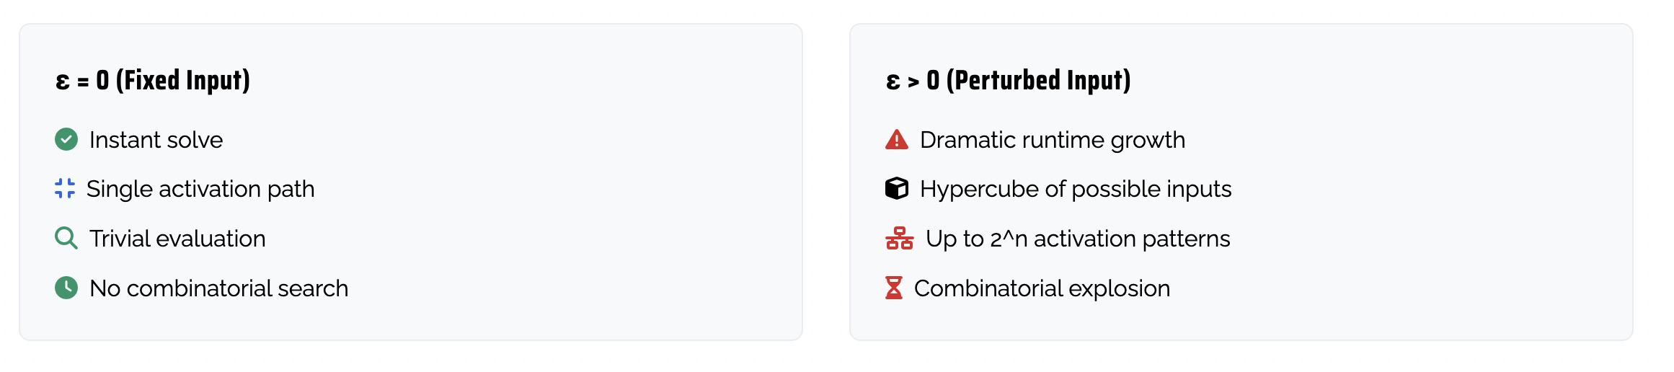
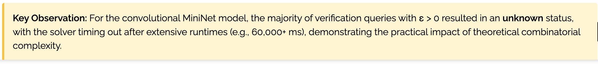
RESULTS SUMMARY: Z3 SOLVER PERFORMANCE

Slide 26
ENGINEERING CHALLENGES & DEBUGGING
Z3 Encoding Challenges
Opaque progress, stalling, and sensitivity to constraint formulations
Floating-point/precision pitfalls; need for tight, consistent bounds
Strategy: Extensive logging and manual SMT formula inspection
Marabou Integration
API/ONNX inconsistencies, unsupported operators
Python binding errors EquationType errors
Docker issues with stale bytecode despite patches
Key Lesson: Research-grade tools can be brittle; debugging requires multi-layers
understanding form Python APIs to C++ bindings and solver semantics

Slide 27
DISCUSSION & KEY INSIGHTS
Verification Funnel is in Theory an Effective Strategy
PGD filters obvious non-robust cases, IBP proves robustness for many cases with a small epsilon and predicts query difficulty, while the expensive SMT solver is reserved for only the hardest, most ambiguous instances.
ReLU Stability Governs Verification Complexity
The most significant determinant of SMT solver runtime is the number of unstable ReLUs – those whose pre-activation interval straddles zero. This explains why small networks like TinyNet were traceable for a small epsilon (where most ReLUs are stable) and why CNNs are so difficult to verify.
General Purpose SMT Solvers are Insufficient for CNNs
While highly expressive, a general-purpose solver like Z3 lack the specialized heuristics needed for scalable analysis of neural network structures, particularly convolutions. The consistent timeouts and unknown results on the MiniNet case study demonstrate the practical limitation.

Slide 28
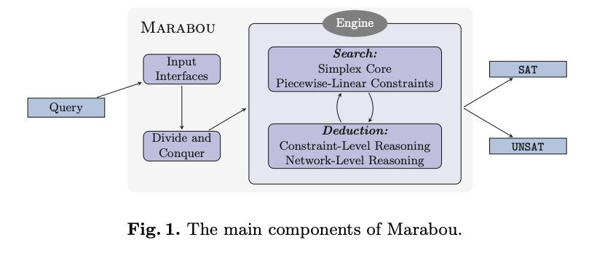
Next Steps I Attempted…
Migrate to specialized verifiers (Marabou) for ReLU handling and bound tightening
Neural Network
+
Set of Linear and
Non-Linear Constraints
Solve as Constraint Satisfaction Problem

Slide 29
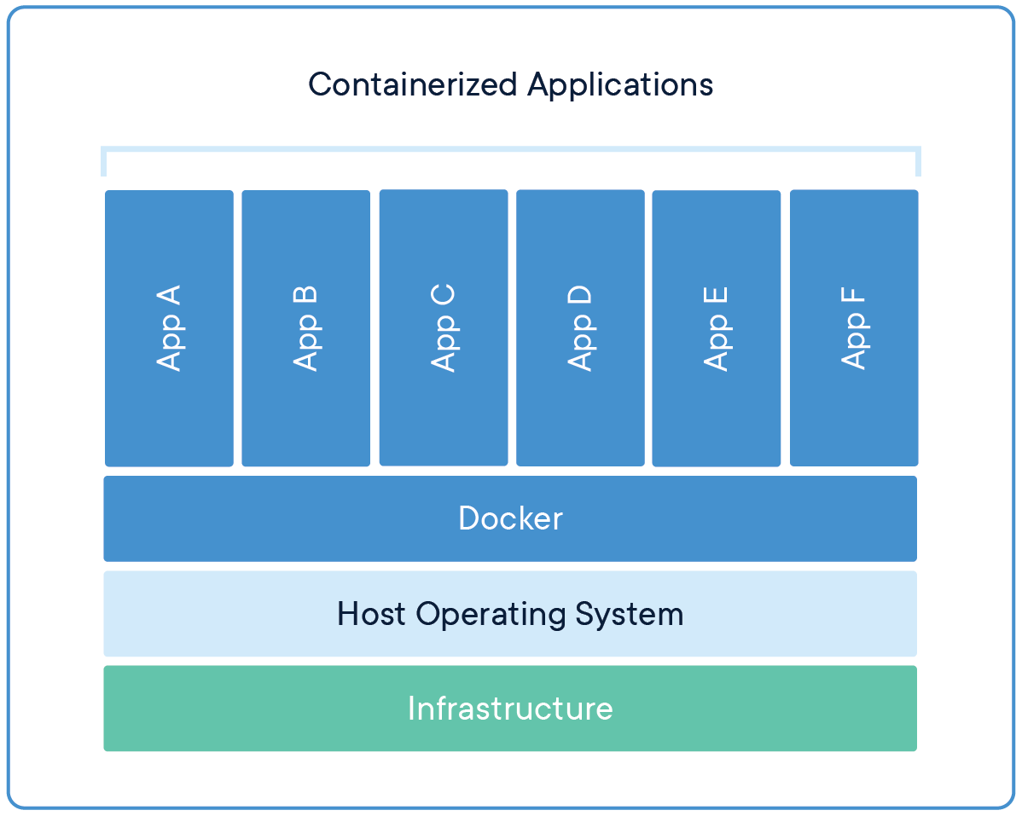
Next Steps I Attempted…
Build scalable, distributed system: Dockerized pipeline + Kubernetes for parallel verification
Application Packaging and Isolation
Portability and Consistency
Efficient Resource Usage
Streamlined Development Workflow
Scalability and Management
Collaboration and Sharing
https://www.docker.com/

Slide 30
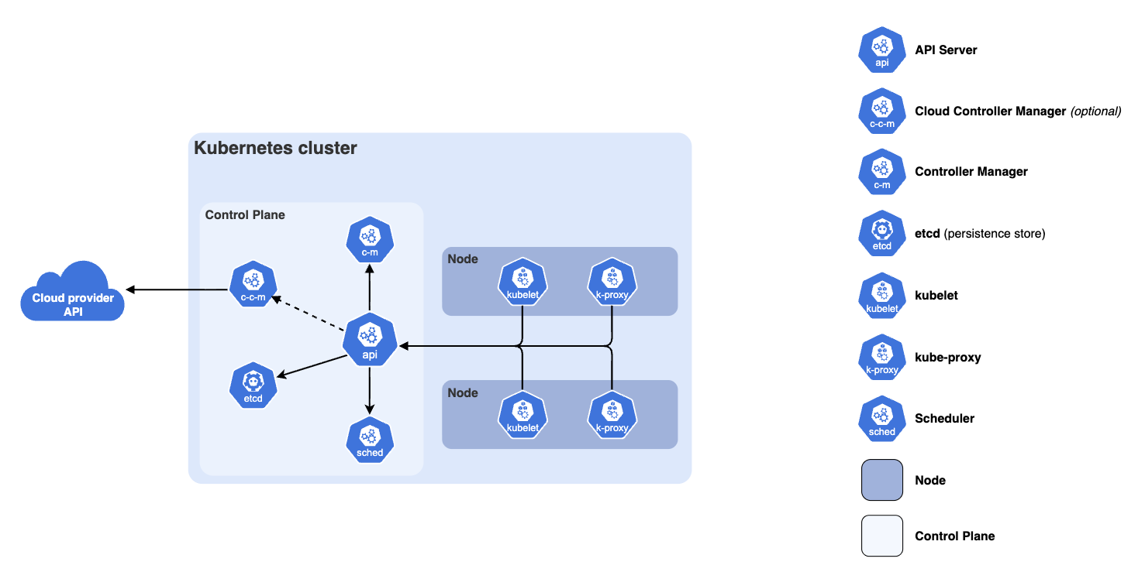
Next Steps I Attempted…
Build scalable, distributed system: Dockerized pipeline + Kubernetes for parallel verification
Automates the deployment, scaling, and management of containerized applications - run, manage, and maintain across a cluster of machines
https://kubernetes.io/

Slide 31
Future Work
Finish Construction using Marabou, Docker, and Kubernetes
Enable dataset-scale formal robustness verification for modern deep learning
Sources
Can be found in GitHub Repo:
github.com/kendallahern/CAV_FinalProject

Slide 32
Computer Aided Verification Final Project
December 2025
Thank You!
Kendall Ahern

Slide 33

Credits
This presentation template is free for everyone to use thanks to the following:
for the presentation template
Pexels, Pixabay
for the photos
HAPPY DESIGNING!

